Slide 1
SQL Workshop

Slide 2
outline
0] What is SQL?
1] What is programming language?
2] Type of programming language.
3] What is a database?
4] structured & unstructured data
5] Relational & Non-relational
6] SQL (What Can SQL do?)
7] Table Meta Data
8] Schema
9] Entities – ATTRIBUTES - RELATIONSHIPS
8] type of Relational db (+Example).
9] SQL Codes

Slide 3


Eng Dana Mohammed Al-Mahrouk
Front-end Developer | Database administrator
Bachelor’s degree in Computer Engineering from BAU.
Two years of experience in databases.
Course in databases.
Front-end projects.
LinkedIn link:
almahrouk6103@gmail.com

Slide 4

What is SQL?
Structured query language (SQL) is a programming language for storing and processing information in a relational database.
A relational database stores information in table form, with rows and columns representing different data attributes and the various relationships between the data values.

Slide 5
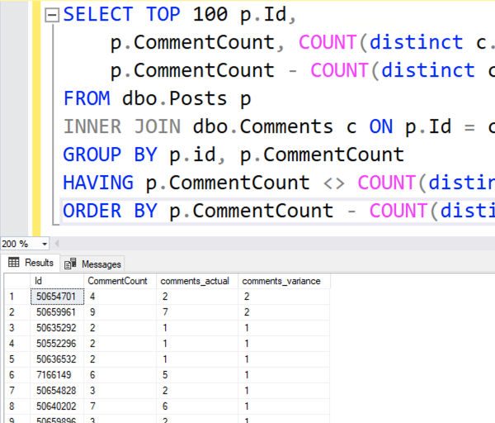
What is programming language ?
A programming language is a formal set of instructions that are used to communicate with computers.
write code that can be understood by computers and executed to perform various tasks or solve specific problems.
Programming languages vary in complexity, purpose, and application. They can be used for a wide range of tasks, including web development, software development, data analysis, artificial intelligence, and more.

Slide 6
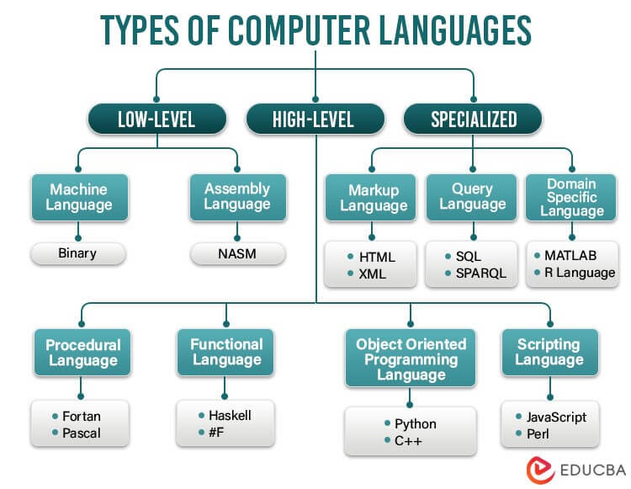

Slide 7
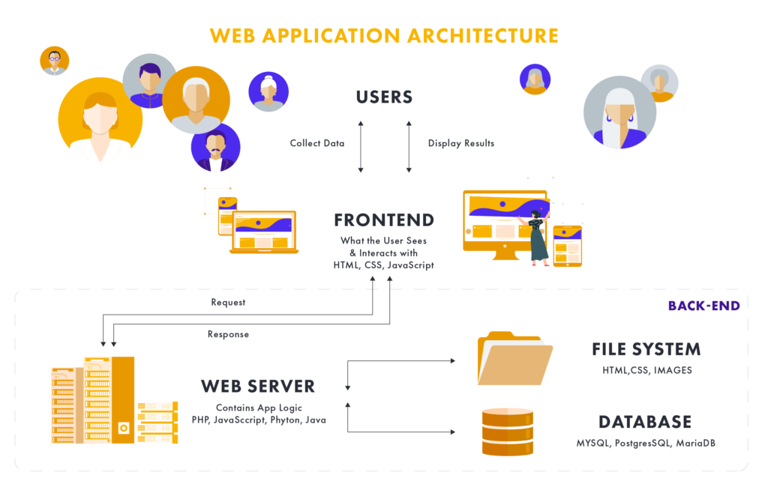

Slide 8
What is a Database?
A Database is a structured collection of data that is organized and stored in a way that enables efficient retrieval, updating, and management of that data.
It serves as a Store of information that can be easily accessed, managed, and manipulated by users or applications.
- commonly used:
business, science, academia, and government.
- Types:
relational DB, NoSQL, object-oriented DB, …

Slide 9


Slide 10
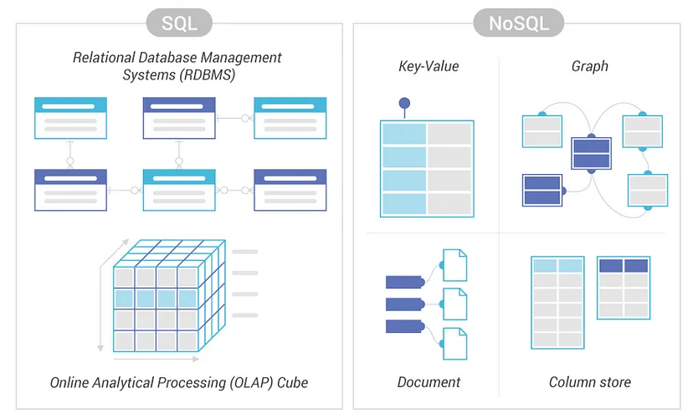
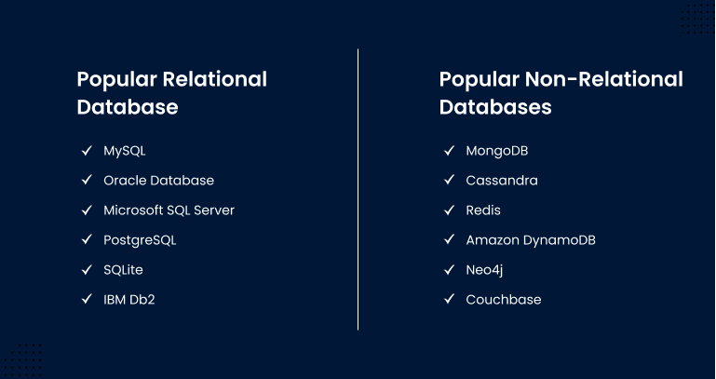
Relational vs Non-relational

Slide 11
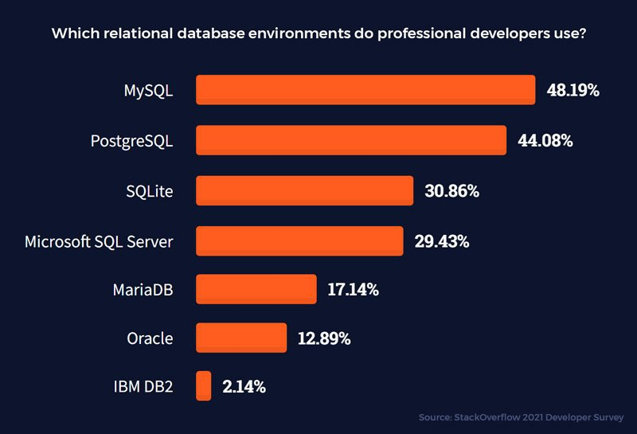

Slide 12

SQL
What Can SQL do?
execute queries against a database
insert records in a database
read data from a database
update records in a database
delete records from a database
create new databases
create new tables in a database
create stored procedures in a database
create views in a database
set permissions on tables, procedures, and views

Slide 13
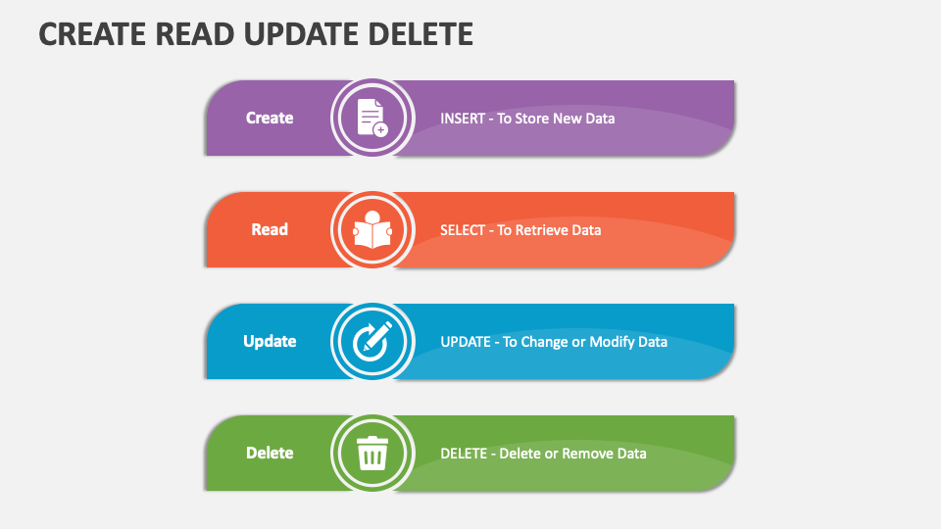

Slide 14
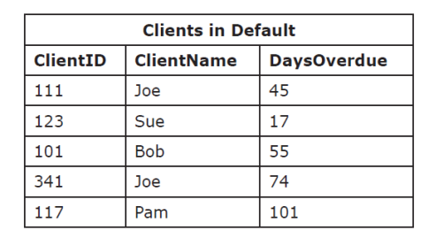
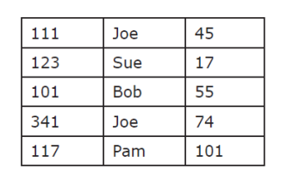
Table Meta Data

Slide 15
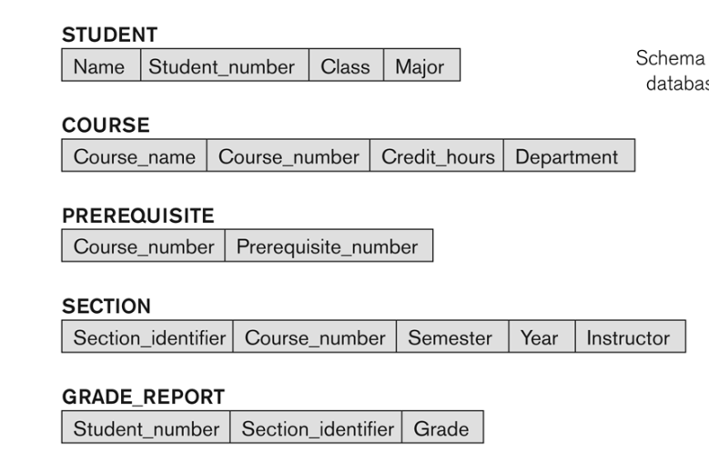
Schema

Slide 16
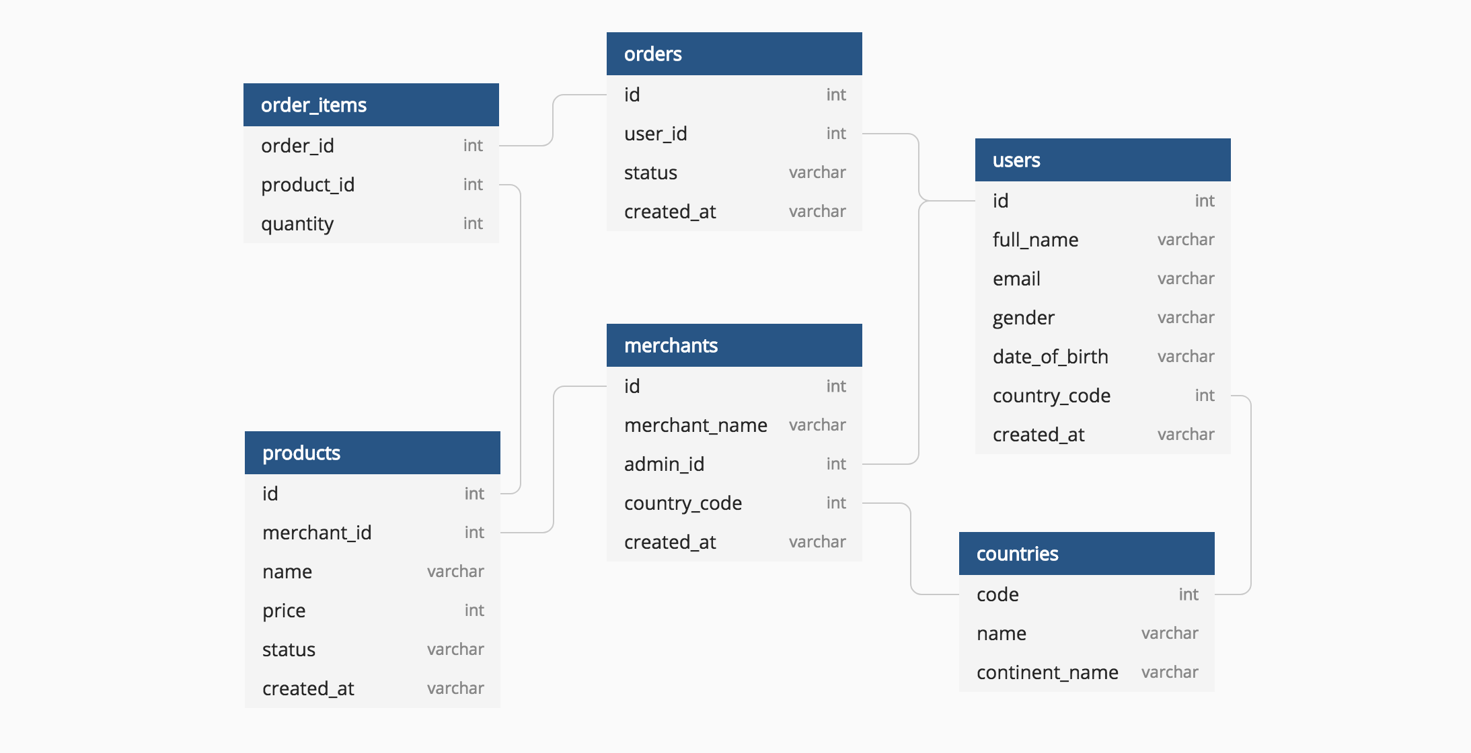

Slide 17
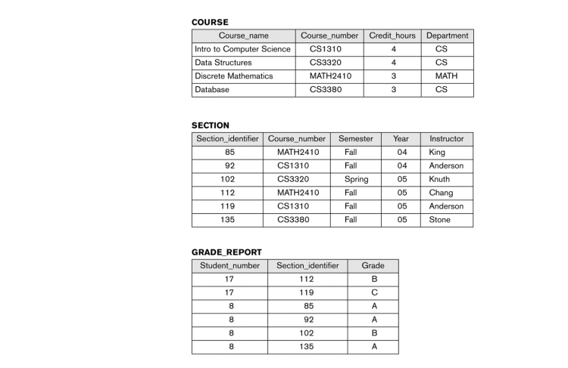

Slide 18
Entities
Example:
Entities: a distinct object, concept, or thing about which data can be stored. It represents a real-world item with characteristics that can be described and managed.
represented in a database by tables, where each row in the table represents a specific instance of the entity, and each column represents an attribute or property of that instance.
• The basic building blocks of an ER diagram
• Represent various real world notions, such as people, places, objects, events, items, and other concepts
• Within one ERD each entity must have a different name
Customer
Product
Student
Subject
Teacher

Slide 19
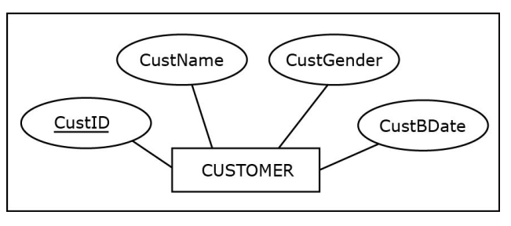
ATTRIBUTES
Attribute - depiction of a characteristic of an entity
• Represents the details that will be recorded for each entity instance
• Within one entity, each attribute must have a different name
Unique Attribute - attribute whose value is different for each entity instance
• Every entity must have at least one unique attribute.

Slide 20
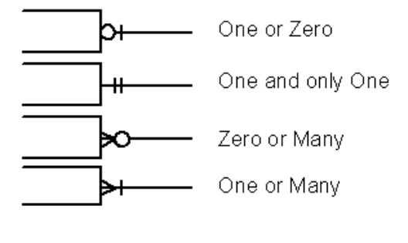

RELATIONSHIPS
• Relationship - ER modeling construct depicting how entities are related
• Within an ER diagram, each entity must be related to at least one other.
• Cardinality constraints - depict how many
instances of one entity can be associated with instances of another entity
• Maximum cardinality
o One (represented by a straight bar: I)
o Many (represented by a crow’s foot symbol: )
• Minimum cardinality (participation)
o Optional (represented by a circular symbol: 0)
o Mandatory (represented by a straight bar: I)

Slide 21
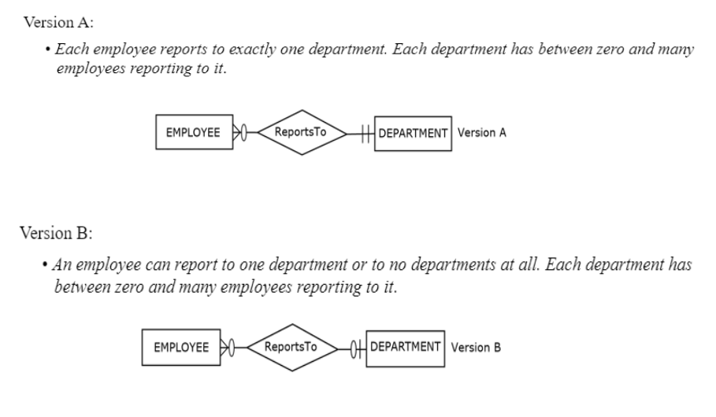

Slide 22
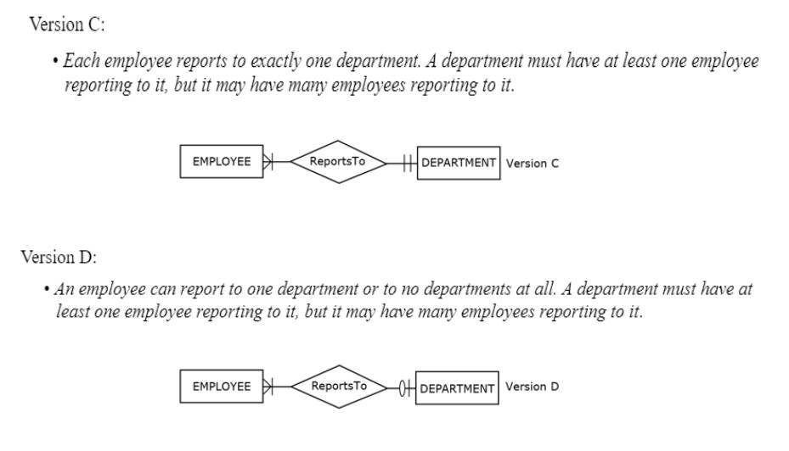

Slide 23
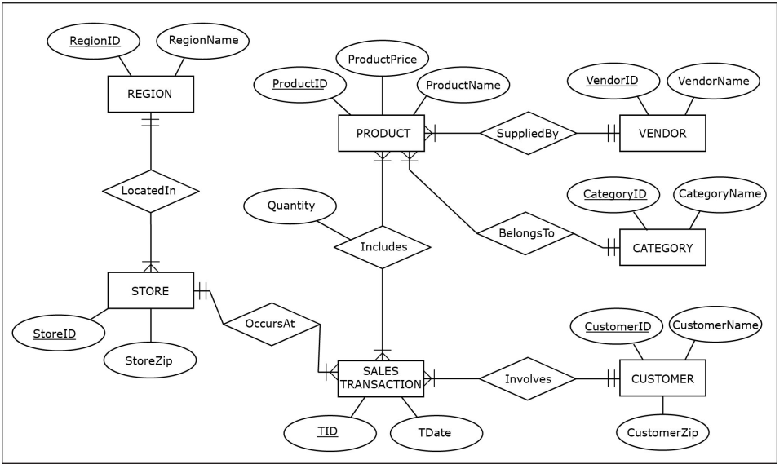

Slide 24
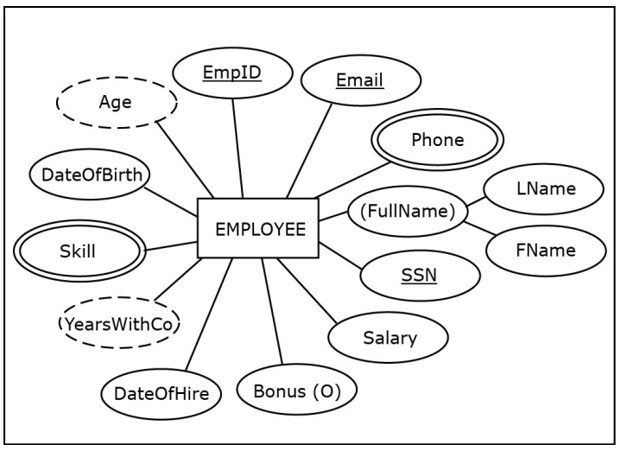

Slide 25
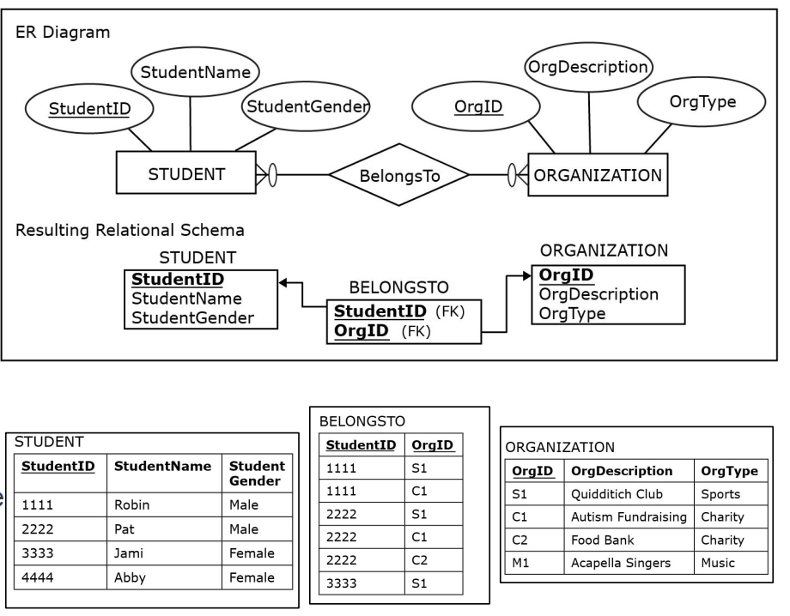

Slide 26
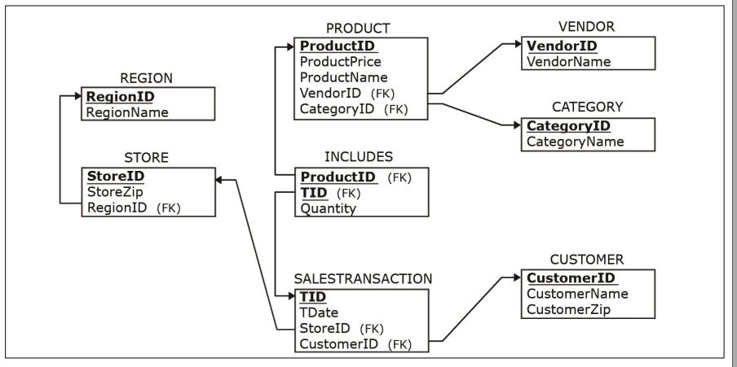

Slide 27
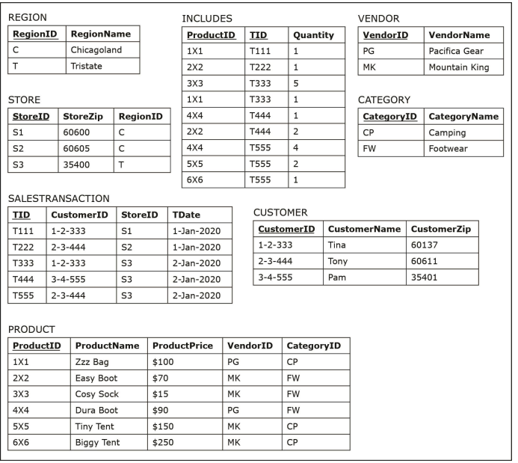

Slide 28
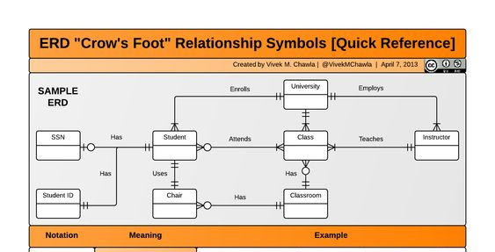

Slide 29
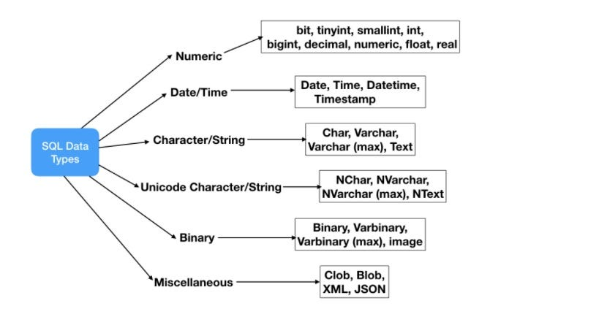

Slide 30
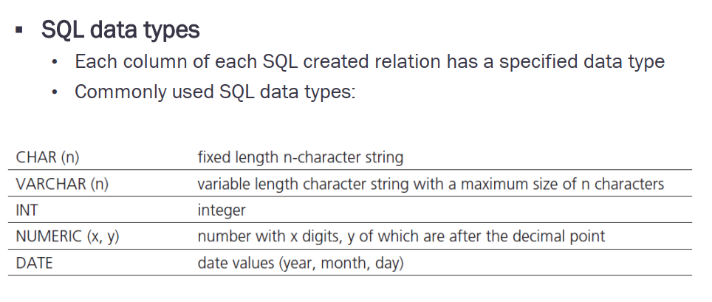

Slide 31
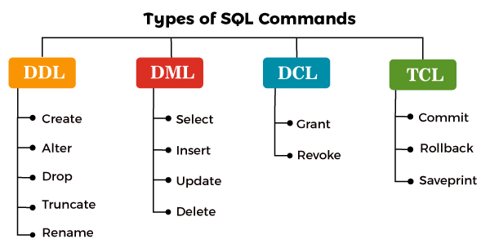

Slide 32
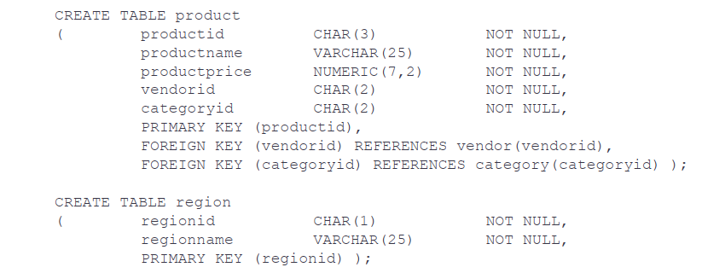
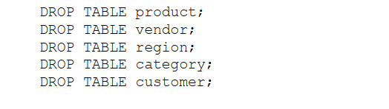

Slide 33
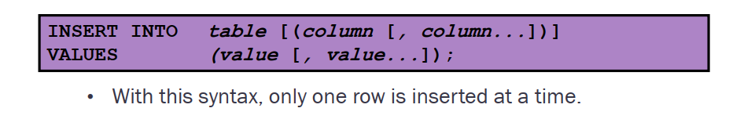
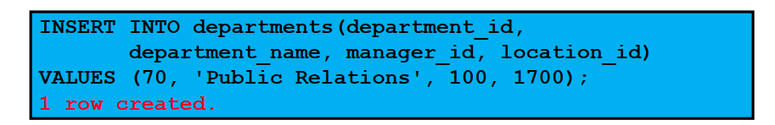
Insert into - values

Slide 34
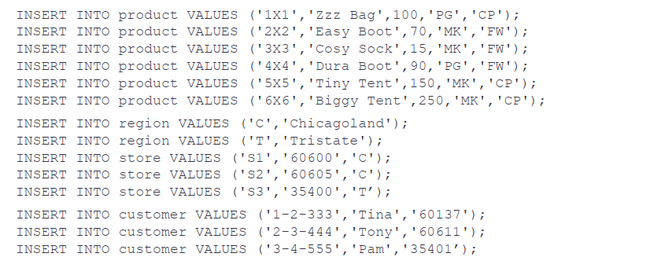

Slide 35
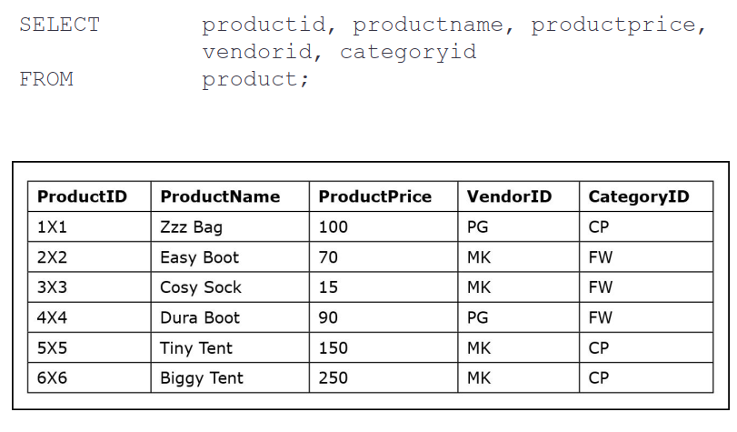
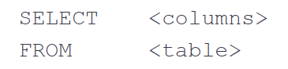
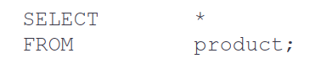
Select - From

Slide 36
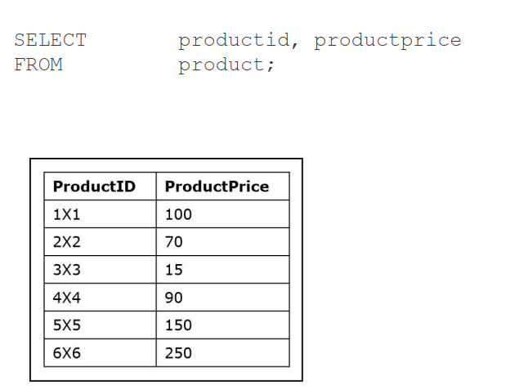

Slide 37
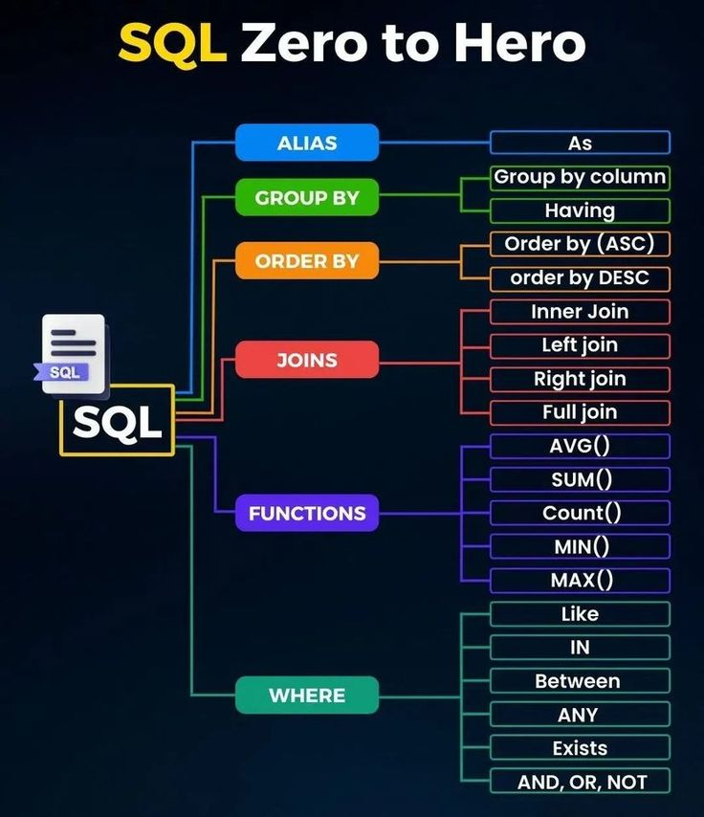

Slide 38
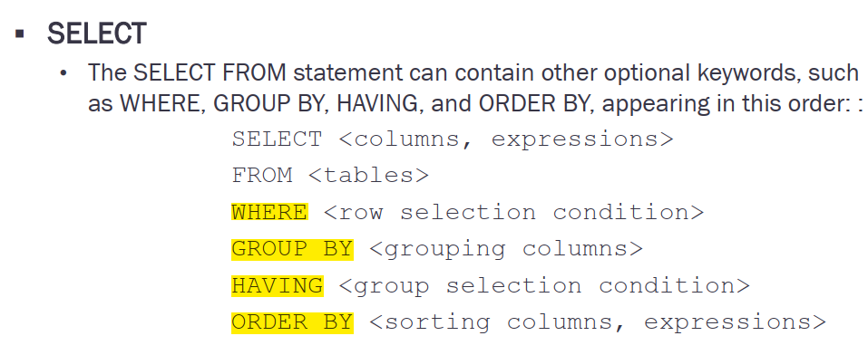

Slide 39
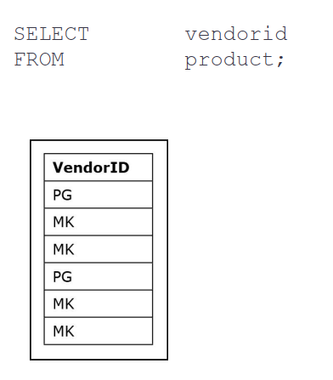
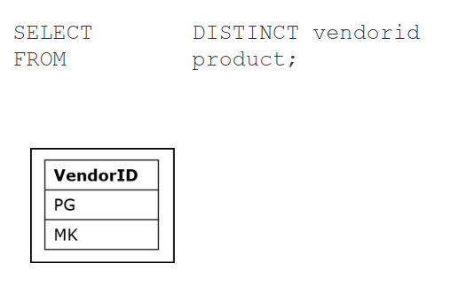
DISTINCT

Slide 40
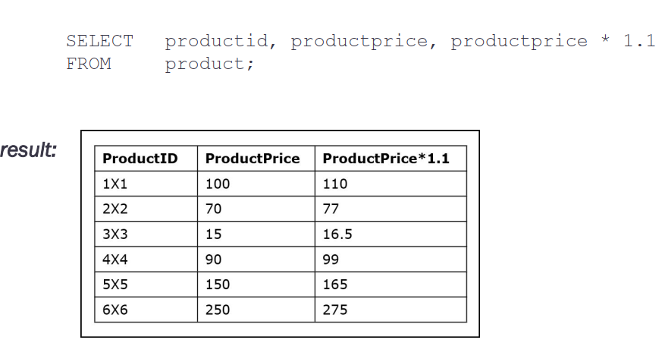

Slide 41
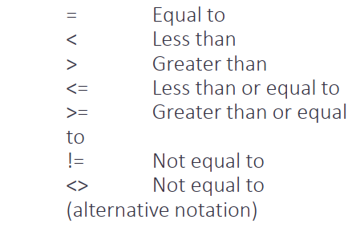
Where

Slide 42
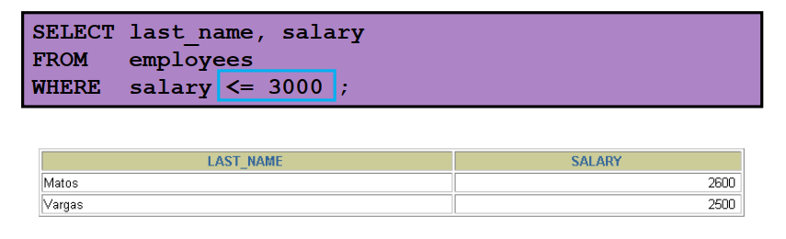
Ex1:

Slide 43
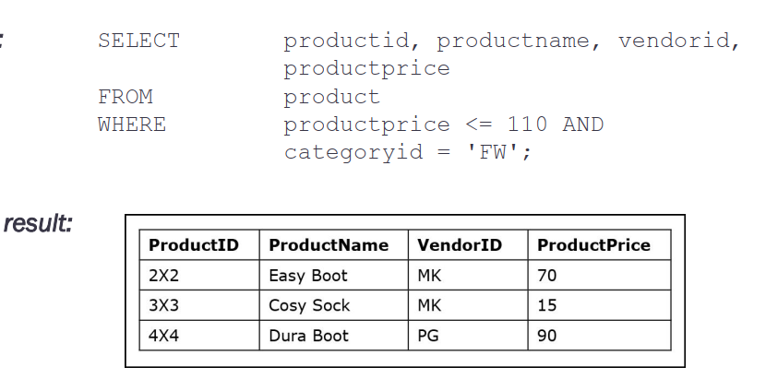
Ex2:

Slide 44
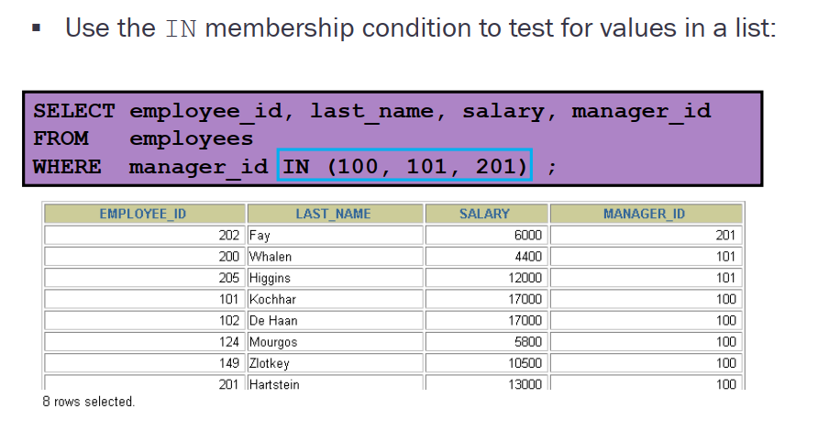
Ex3:

Slide 45
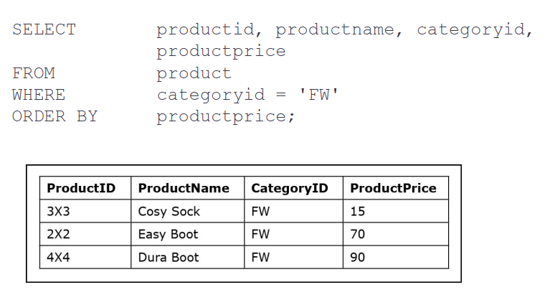
Order By: (low to high)

Slide 46
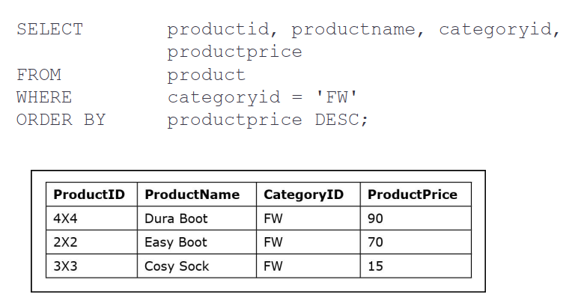
Order By: Desc (high to low)

Slide 47
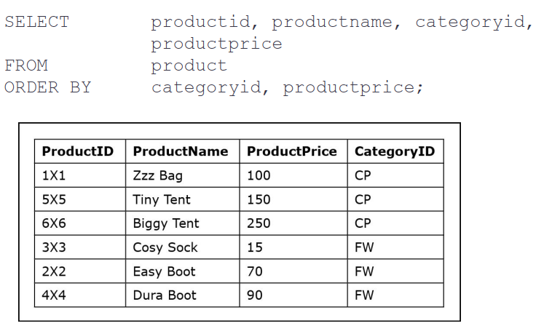
Order By: multi-column

Slide 48
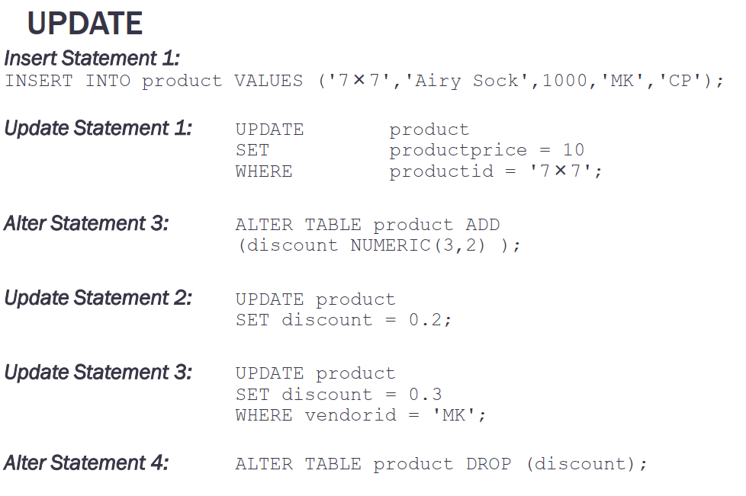

Slide 49

Thanks

